Slide 1
Deep Learning
Lec # 01

Slide 2
Contents
What is Learning?
What is Machine Learning
Feature Learning
Shallow vs. Hierarchical vs. Deep Features (ML vs. DL)

Slide 3
What is Learning?
A computer program is said to learn from experience E with respect to some class of tasks T and performance measure P, if its performance at tasks in T, as measured by P, improves with experience E.
Example:
In a spam detection system,
The experience (E) might be the training data consisting of emails labeled as spam or not spam
The Task (T) correctly classifies new emails as spam or not.
The performance measure (P) could be the accuracy of the classification, which improves as the system processes more emails.

Slide 4
Machine Learning
We can develop algorithms that have the ability to learn without being explicitly programmed. These algorithms include:
Decision trees
Naive Bayes
Random forest
Support vector machine
K-nearest neighbor
K-means clustering
Gaussian mixture model
Hidden Markov model
Notes:
"learning without being explicitly programmed" refers to the model's ability to develop its understanding or rules based on data, rather than relying on hardcoded instructions.

Slide 5
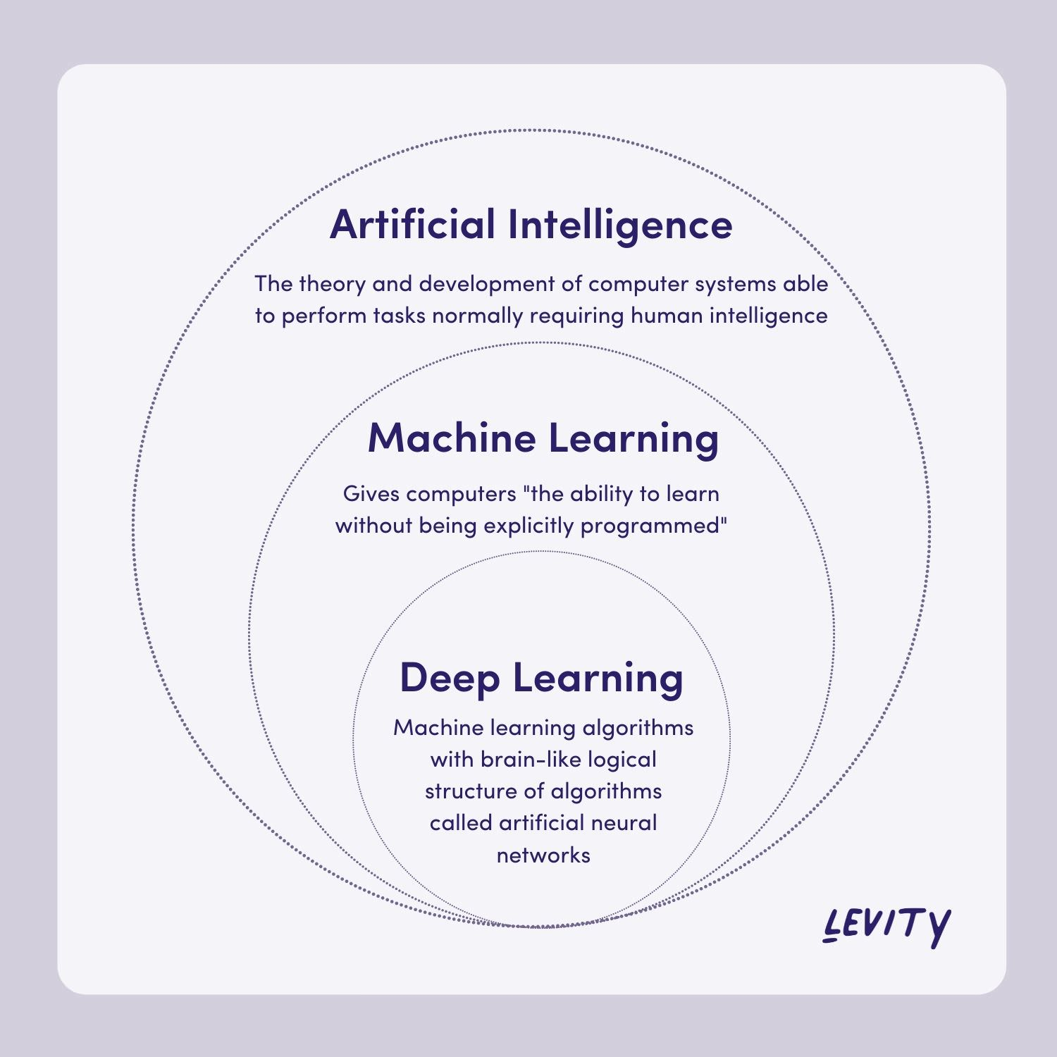
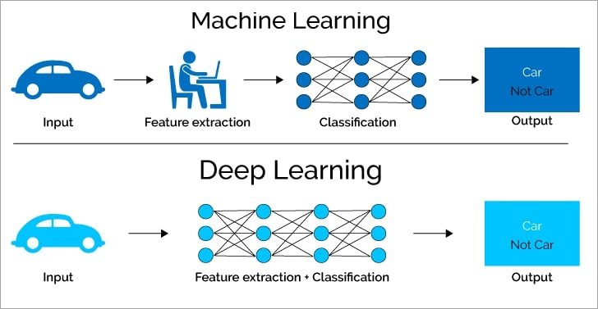

Slide 6
Machine Learning | Deep Learning
ML is an artificial intelligence (AI) methodology. Not all ML is deep learning. | Deep learning is an advanced ML methodology. All deep learning is ML.
Best for well-defined tasks with structured and labeled data. | Best for complex tasks that require machines to make sense of unstructured data.
solves problems through statistics and mathematics. | combines statistics and mathematics with neural network architecture.
You have to manually select and extract features from raw data and assign weights to train an ML model. | Deep learning models can self-learn using feedback from known errors.
less complex with lower data volume. | more complex with a very high data volume.

Slide 7
Types Of Deep Neural Network
Convolutional Neural Network (CNN) :
most commonly used for image analysis.
Recurrent Neural Network (RNN) :
RNN uses sequential information to build a model.
It often works better for models that have to memorize past data.
Generative Adversarial Network (GAN) :
GAN are algorithmic architectures that use two neural networks to create new, synthetic instances of data that pass for real data
Deep Belief Network (DBN):
DBN is a generative graphical model that is composed of multiple layers of latent variables called hidden units.
Each layer is interconnected, but the units are not.
Notes:
A latent variable refers to an unobserved or hidden variable that cannot be directly measured but is inferred from other variables that can be observed or measured.
Latent variables are powerful tools for modeling complex systems, allowing us to capture and utilize hidden patterns that are not immediately visible in the raw data.

Slide 8
Feature Engineering vs Feature Learning

Slide 9
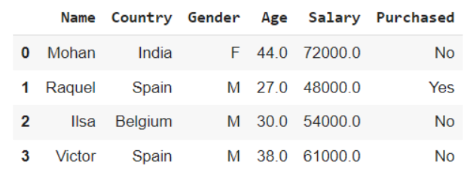
Features:
Types of Features:
Numerical Features: Quantitative values, like age, income, or temperature.
Categorical Features: Qualitative values, like gender, color, or product types.
Text Features: Words or phrases, often used in natural language processing.
Image Features: Pixels or shapes in image data.
A feature (also known as a variable or attribute) is an individual measurable property or characteristic of a data point that is used as input for a machine learning algorithm

Slide 10
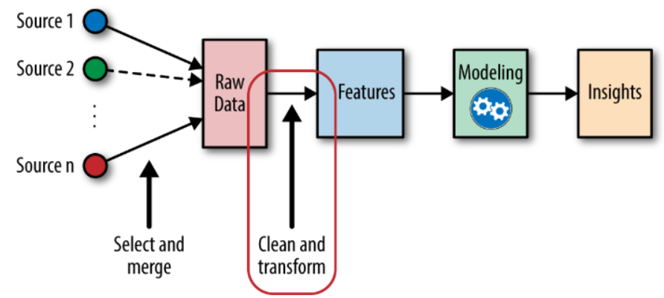
Feature Engineering
Feature Engineering is about manually creating feature
process of transforming raw data into features that are suitable for machine learning models
Processes Involved in Feature Engineering
Feature Creation: The process of generating new features based on domain knowledge or by observing patterns in the data
Feature Transformation: The process of transforming the features into a more suitable representation for the machine learning model
Feature Selection: The process of selecting a subset of relevant features from the dataset
Feature Extraction: The process of creating new features from existing ones to provide more relevant information
Feature Scaling: The process of transforming the features so that they have a similar scale.
Types of Feature Scaling:
Min-Max Scaling
Standard Scaling
Robust Scaling: Rescaling the features to be robust to outliers by dividing them by the interquartile range.

Slide 11
Feature Learning
Is the process by which a model automatically discovers and learns representations (features) from raw data.
Methods:
Deep Neural Networks: Layers of neurons learn increasingly abstract features from raw data.
Autoencoders: Networks that learn compressed representations of data.
Convolutional Neural Networks (CNNs): Automatically learn spatial hierarchies of features from images.
Word Embeddings: Techniques like Word2Vec learn vector representations of words from text.

Slide 12
Shallow Features (ML)
Description:
In traditional machine learning, features are often manually engineered or selected based on domain knowledge. These features are typically shallow, meaning they are derived directly from the raw data and may not capture complex patterns.
Example:
In a text classification problem, shallow features might include word counts, TF-IDF scores, or other simple statistical measures.

Slide 13
Hierarchical Features (ML & DL)
Description:
Hierarchical features involve more complex interactions between features, whereas higher-level features are composed of lower-level ones. In some cases, machine learning models can be designed to automatically learn these hierarchical representations.
Example:
In a convolutional neural network (CNN) used for image recognition, the first few layers might detect edges, followed by shapes, and finally more complex structures like objects.

Slide 14
Deep Features (DL)
Description:
Deep features are automatically learned representations derived from multiple layers of a deep learning model. These features are typically much more abstract and complex, capturing intricate patterns in the data that are difficult to express with shallow features.
Example:
In a deep neural network used for speech recognition, deep features might represent phonemes, syllables, and even word structures.
Notes:
Intricate : complex

Slide 15
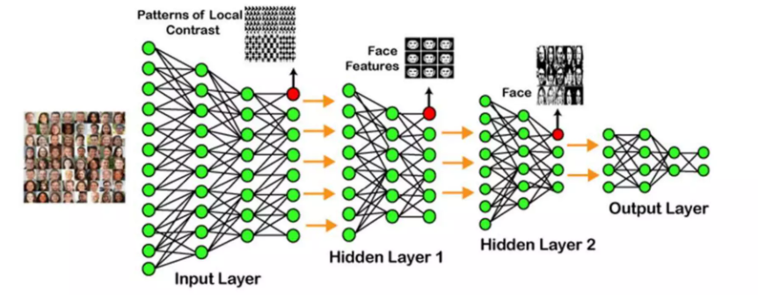

Slide 16
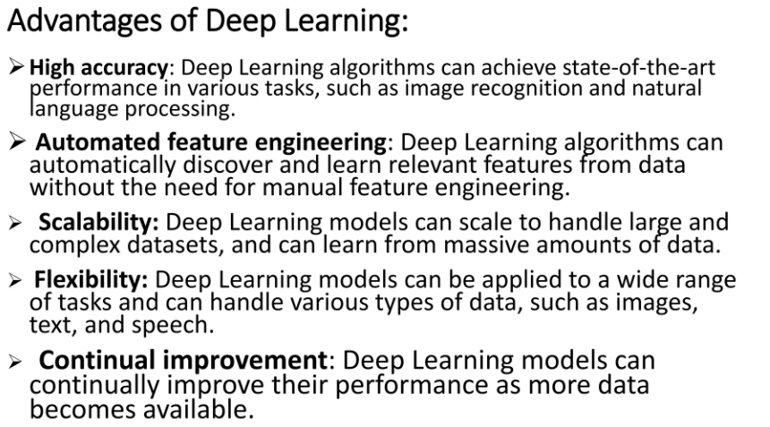

Slide 17
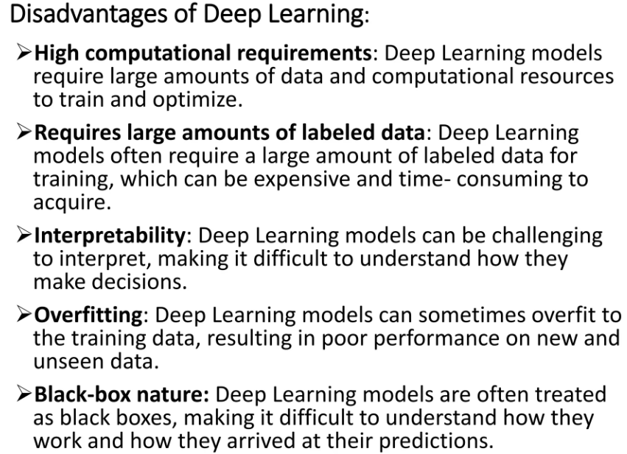

Slide 18
